Slide 1

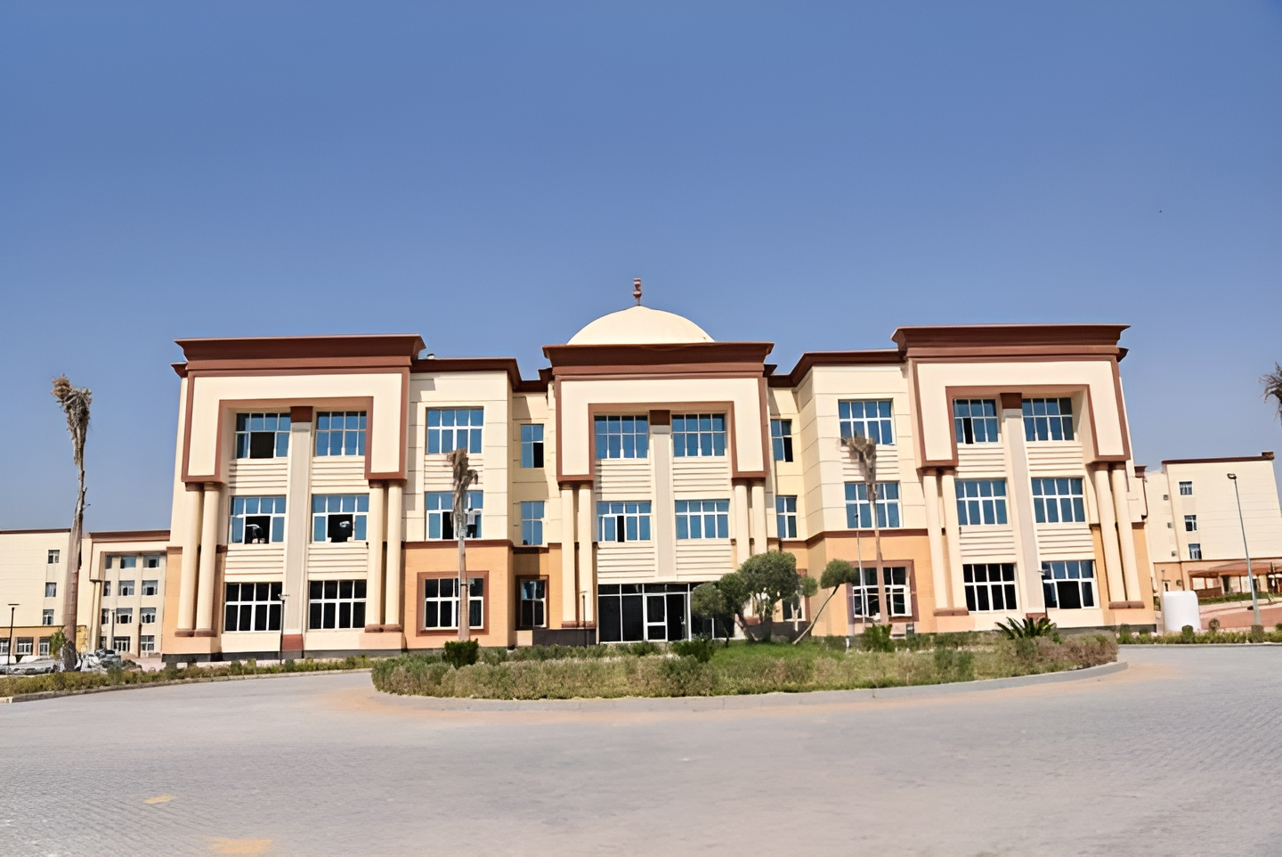



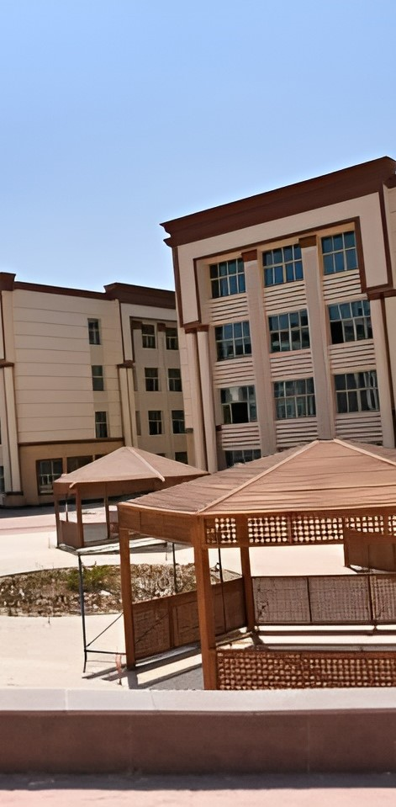
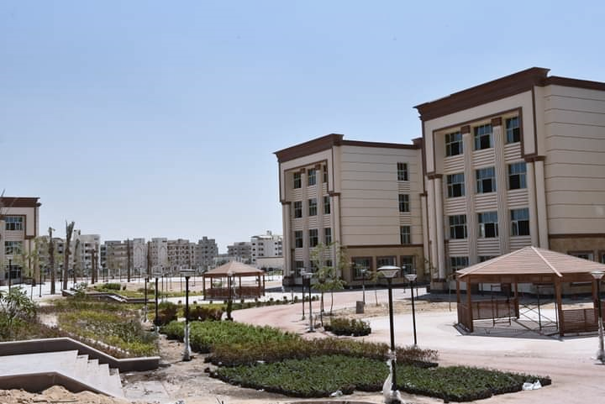
ANU
PROJECT
Computer Science and Information Portal

Slide 2

01
02
03
Introduction
(ER)
(ERD)
OVERVIEW
04
05
06
Gantt Chart
DFD – Level 0
DFD – Level 1
07
08
09
DFD – Level 2
UI Design
Our Team

Slide 3



01
Introduction
Project Overview
Our Goals
This project focuses on creating a comprehensive web portal for Assiut National University’s Faculty of Computer Science and Information. It aims to simplify academic processes like course registration, attendance tracking, and student-instructor communication, fostering an organized and efficient academic experience
Our goals are to improve access to academic resources and streamline communication between faculty and students. We aim to create a seamless system for managing courses, grades, and feedback to enhance the educational experience.

Slide 4
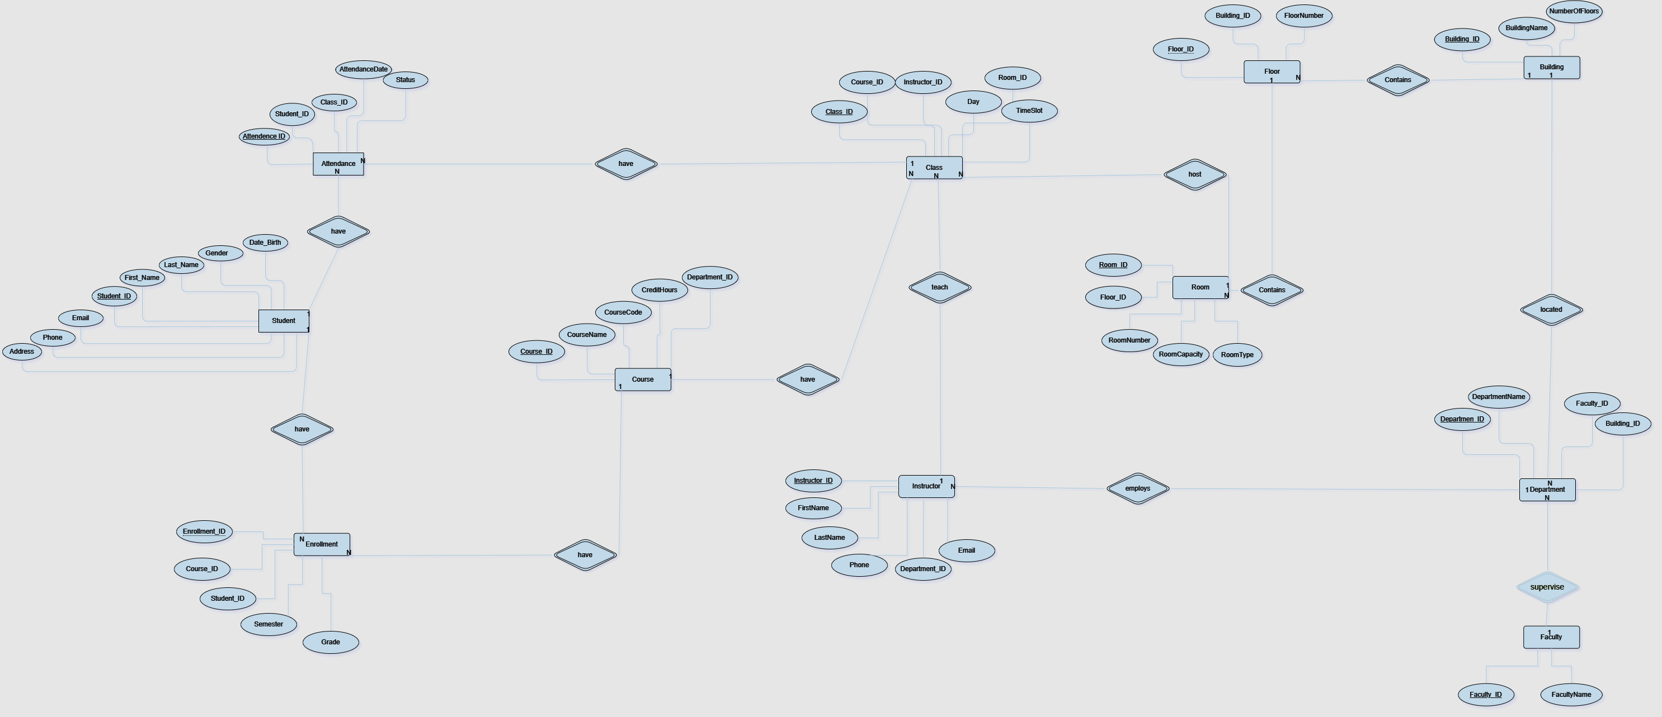
02
Entity-Relationship (ER)
This ER diagram represents the logical relationships between the main entities in the system, including students, instructors, courses, and resources

Slide 5
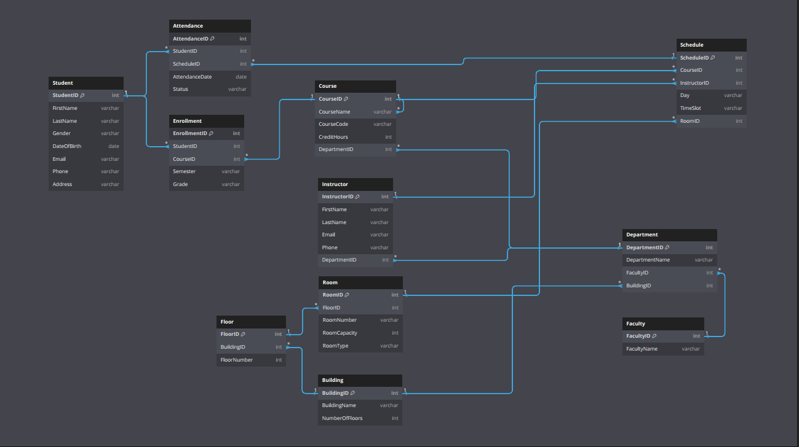
03
Entity-Relationship Diagram (ERD)
The ERD expands on the ER diagram, detailing attributes and primary/foreign key relationships for accurate database design

Slide 6
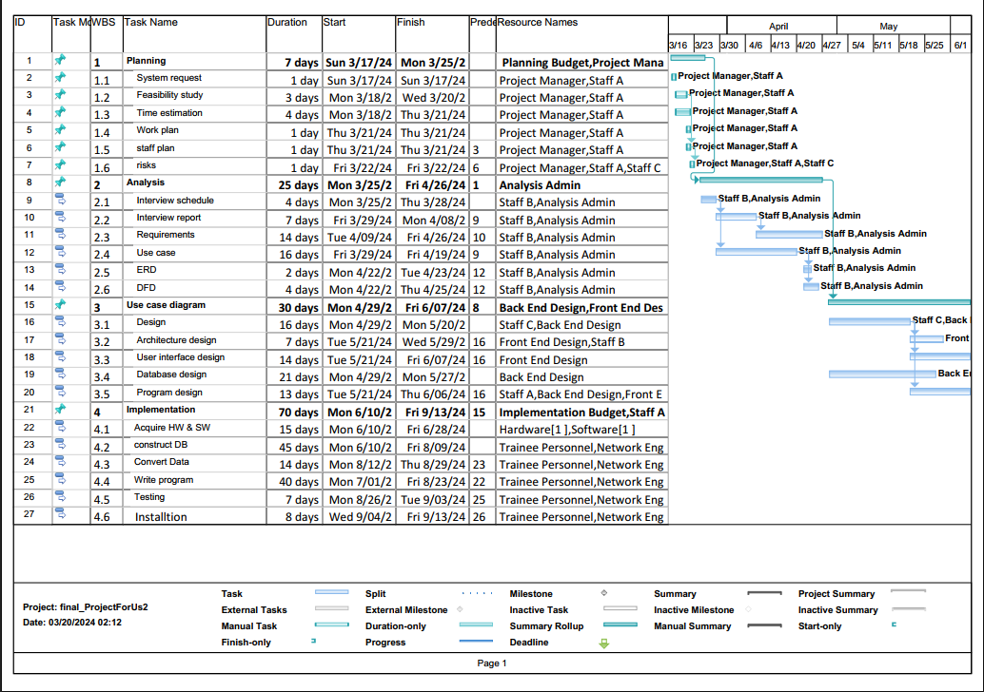

04
Gantt Chart
Description
This Gantt chart outlines the project schedule, key milestones, and progress to date, ensuring effective time management and delivery

Slide 7
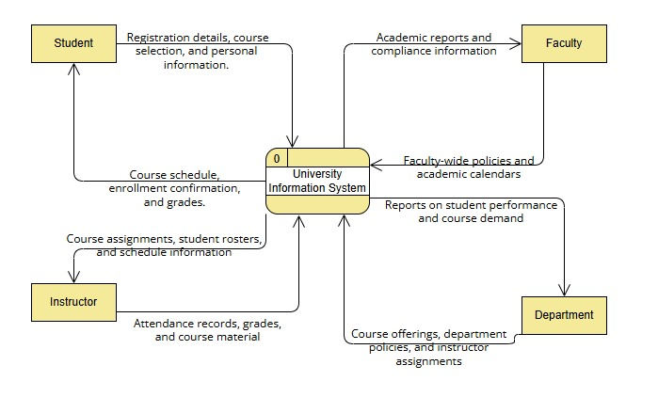
Data Flow Diagram
05
DFD Level 0 Context Diagram

Slide 8
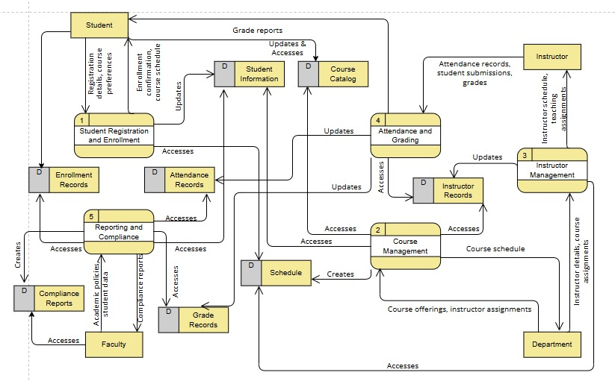
Data Flow Diagram
06
DFD Level 1 High-Level System Functions

Slide 9
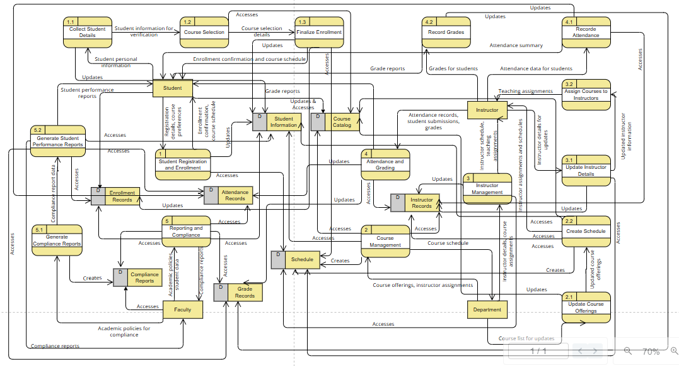
Data Flow Diagram
07
DFD Level 2: Detailed Process View

Slide 10



08
UI Design
These UI mockups were designed using Figma, showcasing a user-friendly layout focused on accessibility and functionality. Explore the full design here: Figma UI Design Link

Slide 11

09
OUR TEAM
يوسف محمد نصر الدين
عبد الرحمن ياسر محمود
احمد ضياء الدين كامل
محمد خالد عبد الهادي رماح
عمر عبد الرحمن مصطفي
محمد أسامة محمد محمود
محمود حسين محمود جابر
عبد الرحمن ناصر فتحي

Slide 12



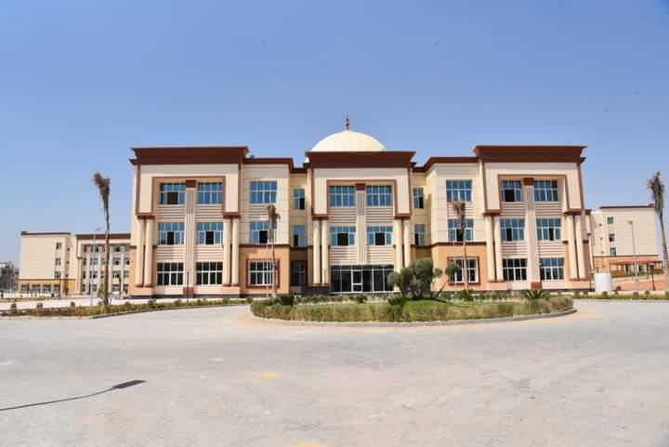
THANK YOU
CONNECT WITH US.
+123-456-7890
asnu.edu.eg

